Slide 1
Why Should Christians Support Israel’s Right to the Land?
Dr. Marty Marriott

Slide 2
In light of Iran’s stated aim of annihilating Israel, why do so many American Jews support the deal?

Slide 3
They support the deal for the same reason that the minority of non-Jews do. Their outlook on life has been shaped by the Left.

Slide 4
A correct understanding of who the woman represents is a critical issue for understanding the Book of Revelation as a whole and for understanding Israel’s role in God’s plan.

Slide 5
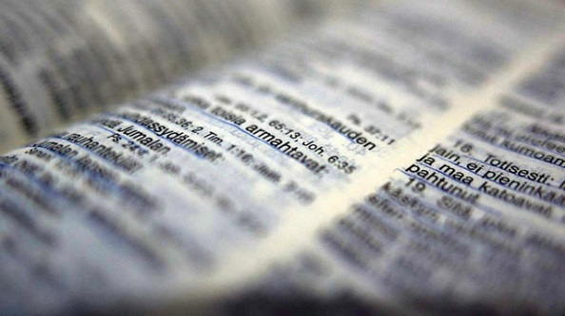
A Biblical Worldview
A proper understanding of Israel’s place in the world and in prophecy is part of a
Christian worldview.

Slide 6
I. Who They Are Who are the principal personalities?

Slide 7
The woman is symbolic. The woman is Israel. Hebrews 2:16; Romans 9:5; Genesis 37:9-11

Slide 8
The Great Red Dragon is Satan (9). ‘His angels’ are demons. Originally, they were stars or angels but followed Satan. (See Job 38:7; Matthew 25:41)

Slide 9
Satan’s Preoccupation "stood before the woman" Initially, Satan worked to prevent the coming of Messiah; then, he worked to destroy Him; and now, he works to prevent His return.

Slide 10
In the Old Testament
The disqualification of Cain (1 John 3:12)
Corruption of the human race (Gen 6)
Pharaoh (Exodus 1:15-16)
Queen Athaliah (2 Chronicles 22:10)
Haman (Esther 3:6)

Slide 11
In the New Testament
King Herod (Matthew 2:13-18)
Satan tempts Jesus (Matthew 4:1-11)
Satan indwells Judas (John 13:26-27)

Slide 12
During the Church Age
Throughout the Church Age, Satan has continued his work to destroy Israel and completely exterminate the Jewish race.
Consider two examples:
1) The origin and ascendancy of Islam
2) Hitler's holocaust

Slide 13
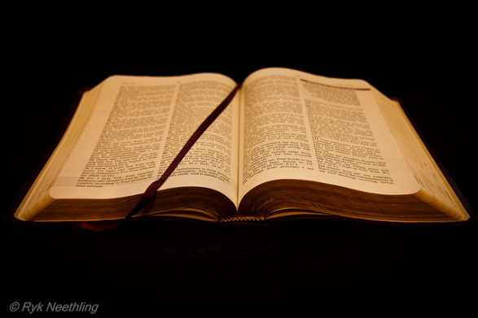
Apparently, Satan believes that by exterminating the Jews he can prevent the return of Jesus and his own prophesied destruction. Never!

Slide 14
II. What they do
What are these personalities doing?

Slide 15
In a very condensed history, the woman gives birth, is persecuted, and flees to the wilderness.

Slide 16
Satan sought to prevent the birth of Messiah and seeks to destroy Israel and slay all Jews. Revelation 12:17 wroth with the woman Revelation 12:4 stood before the woman to devour Revelation 12:7 the dragon fought (Israel is the focus, though the fighting is in the heavens) Revelation 12:13 persecuted the woman Revelation 12:16 flood which the Dragon cast out Revelation 20:2 dragon bound (giving Israel rest)

Slide 17
It is unwise to dismiss unbelieving Israel’s presence in the land as being insignificant to the plan of God.

Slide 18
III. How They Apply
How does this account
apply to us?

Slide 19
We ought to support the right of Israel to occupy the land of God’s promise.
The existence of the state of Israel in the land of promise is necessary to fulfill the many prophecies of the end-time events

Slide 20
B. We ought to recognize Satanic attempts to thwart God’s plan.
We must recognize that many political and religious attacks on Israel and the Jews are Satanic attacks on God’s promises.

Slide 21
The Dragon, Satan, fights today against the woman, Israel, because he will not be judged as long as Israel is unconverted!

Slide 22
MBU MINISTRY PRESENTATION
September 7, 2015
March 12, 2023

