Slide 1
The fullness of time
The Preparation of the World for
the Coming of Christ
and the Birth of the Church

Slide 2
Introduction
When Paul speaks of the “fullness of time” in Galatians 4:4, he means either that
God filled a particular time with significance by entering it in the Person of His Son; or
God prepared a particular time to be the perfect setting for His entry into time in the Person of His Son
Or, perhaps, he intends both

Slide 3
Introduction
In what ways did God prepare the world for the coming of Christ and the birth of the church?
We will consider six areas:
Political Unity
Jewish Patriotism
Economic Conditions
Urban Living Conditions
Religious and Philosophical Environment
Roman Morality

Slide 4
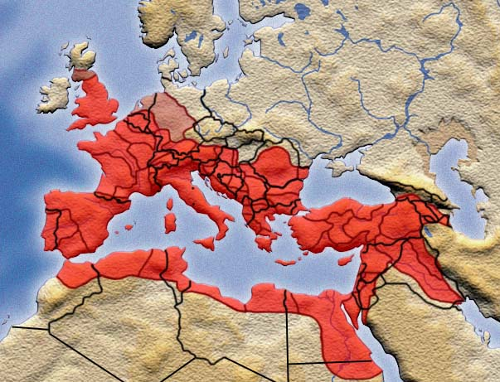
Political unity

Slide 5
Political unity
Aspects of this Unity
One Government
The Pax Romana (30 BC – AD 180)
Senatus Populusque Romanus
One Law
One Language
Greek – lingua franca
One Road System
250,000 miles of paved roads

Slide 6
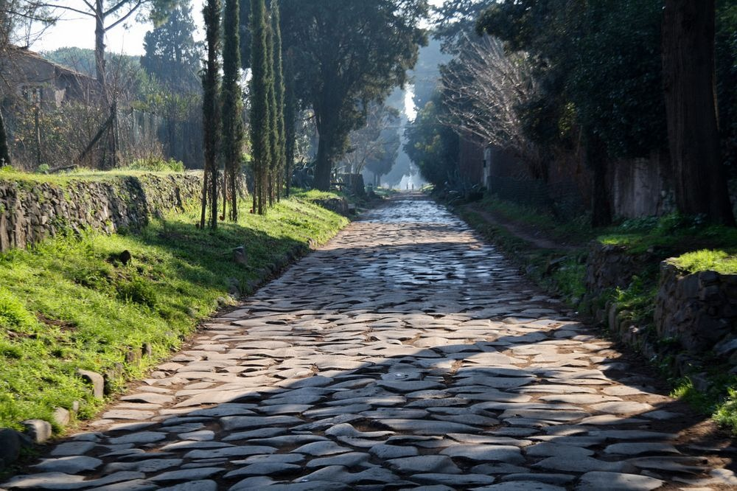
Appian Way

Slide 7
Political unity
Aspects of this Unity
One Government
The Pax Romana (30 BC – AD 180)
One Law
One Language
Greek – lingua franca
One Road System
250,000 miles of paved roads
One Postal System

Slide 8
Political unity
Effects of These Unities
Missionary expansion
Rapid and relatively safe transportation
Greek spoken from Spain to Persia
Safe transmission of correspondence over large areas

Slide 9
Jewish patriotism

Slide 10
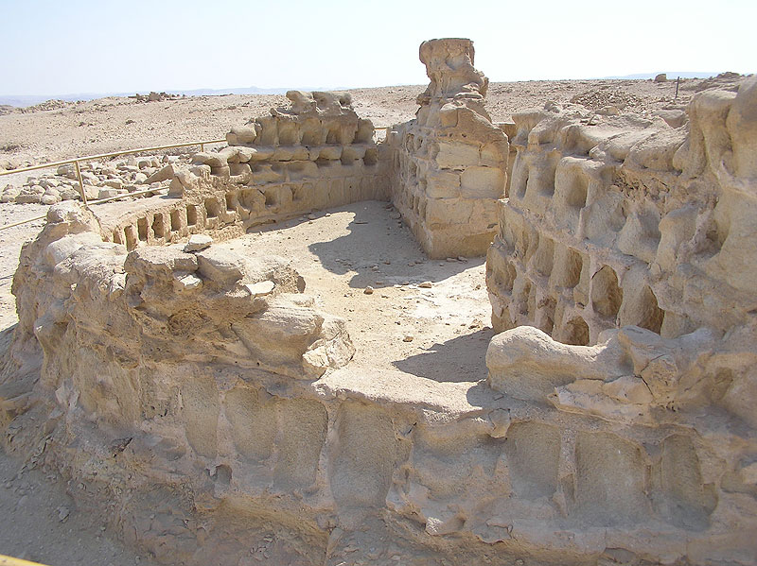
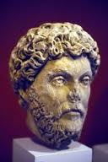
Jewish patriotism
Jews were most fiercely independent of peoples subject to Rome
Major Jewish revolts
AD 66-73
AD 132-135

Slide 11
Jewish patriotism
Destruction of the Temple in AD 70
Passing of old order
Council of Jamnia in AD 90
Reorientation of Judaism
Temple to Synagogue
Sacrifice to Torah (as during exile)
Destruction of Jerusalem in AD 135
Christianity emerged from shadow of Judaism as a distinct religion

Slide 12
Economic conditions

Slide 13
Economic conditions
Thin crust of wealthy citizens
Majority of population poor
Huge segment (30-50%) slaves
Highly stratified society with power centralized in the hands of the rich

Slide 14
Economic conditions
Christ was poor and identified with the poor – “Blessed are the poor” (Luke 6:20)
The NT issues strong warnings to the rich
1 Tim 6:6-10; James 2:1-7; 5:1-5
No indication that wealth has intrinsic value
Christianity introduced a new value system

Slide 15
Economic conditions
Christianity spread in its first three centuries primarily among
Women
The Poor
Slaves
“Not many mighty, not many noble, …” (1 Cor 1:26-31)

Slide 16
Economic conditions
The Early Church was skeptical of those who seemed to be seeking wealth
Welcome every apostle on arriving, as if he were the Lord. But he must not stay beyond one day. In case of necessity, however, the next day too. If he stays three days, he is a false prophet. On departing, an apostle must not accept anything save sufficient food to carry him till his next lodging. If he asks for money, he is a false prophet (Didache 11).

Slide 17
Urban living conditions

Slide 18
Urban living conditions
The Roman Empire was largely rural by modern standards
Several very large cities
Rome was the largest, peaking at about 1,200,000 people
Alexandria and Antioch had nearly a million at their peaks
Water was supplied to these cities via massive aqueducts

Slide 19
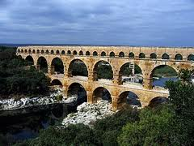
Urban living conditions

Slide 20
Urban living conditions
Roman Engineering
Some palaces covered 30 acres
Rome boasted six-story buildings
Best homes had indoor plumbing
Rome had a large underground sewer system
Public baths and public latrines were common
Living conditions in AD 1 closer to modern times than in AD 1400

Slide 21
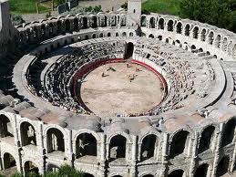
Urban living conditions

Slide 22
Urban living conditions
Paul’s “Urban Strategy”
Paul’s three “missionary journeys” covered about 10 years
He spent nearly 5 of them in Corinth and Ephesus
Urban hubs: Antioch, Ephesus, Corinth, Rome
Paul trained and sent out church planters into the surrounding areas
E.g., Epaphras into the Lycus Valley

Slide 23
review
Preparing for Christ and the Church
We will consider six areas:
Political Unity
Jewish Patriotism
Economic Conditions
Urban Living Conditions
Religious and Philosophical Environment
Roman Morality

Slide 24
Religious and philosophical environment

Slide 25
Religious and philosophical environment
Christianity was not born in a religious vacuum
Roman Empire intensely religious and quite pluralistic
Christianity made its way against some of the great philosophical and religious rivals in world history

Slide 26
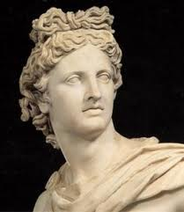
Religious and philosophical environment
Greek and Roman Pantheon
Widespread veneration of the Greek and Roman gods
Worship at private shrines
Rampant polytheism
Note Paul’s argument in
Athens (Acts 17)

Slide 27
Religious and philosophical environment
Cult of the Emperor
Universal, mandatory worship for anyone in Roman Empire
Citizenship oath included Caesar Domine – Caesar is Lord
Christian refusal = political rebellion

Slide 28
Religious and philosophical environment
Greek and Roman Philosophy
The upper classes were influenced by the great Greek and Roman philosophers
This thinking filtered down through society
In Greek ethics, Virtue consists of Prudence, Justice, Fortitude, and Temperance
Notice the absence of Humility
Intellectual arrogance

Slide 29
Religious and philosophical environment
Competing Religions
Judaism – Jews, found in every major Roman city, were Christianity’s most formidable opponent
Mystery Religions
Popular alternatives to the old gods and goddesses
Consisted of secretive, fanatical adherents
Usually dominated by a powerful priesthood

Slide 30
Religious and philosophical environment
Competing Religions
Mystery Religions
Many contained fragments of truth (i.e., they were syncretistic)
The story of Osiris was a resurrection story based on the changing of the seasons
Some of the mysteries employed sacramental rites similar to baptism and the Lord’s Supper

Slide 31
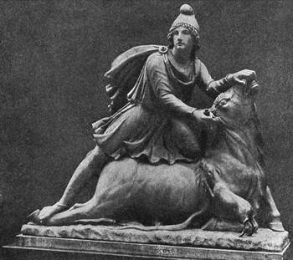
Religious and philosophical environment
Cult of Mithras
Popular in the Roman army
Taurobolium
Initiate stood in a pit and was sprinkled with the blood of a bull that was being killed above him
“Born again for eternity” through the blood of the bull

Slide 32
Religious and philosophical environment
Gnosticism
Biblical terminology
Christ, Word, Savior, redemption
Claimed to believe Christian Scriptures (or parts of them)
Salvation achieved by the predestined through special knowledge (gnosis)
Complex systems of thought based on speculations of a charismatic leader
Most serious pagan rival to Christianity

Slide 33
Religious and philosophical environment
Christianity vindicated itself against a variety of rivals
Between AD 30 and AD 300, Christianity emerged as the dominant religion in the Western World
Grew from about 2,000 to nearly 10 million

Slide 34
Roman morality

Slide 35
Roman Morality
Immorality rampant in Roman society
Human philosophy/religion unable to solve man’s deepest problems
Roman society reminds us of the postmodern society in which we live

Slide 36
Roman Morality
Violence
Constant wars made violence and death a common spectacle
Gladiatorial contests
Death for sport
Animals pitted against each other
Men pitted against animals and against each other
These contests were not discontinued until AD 404

Slide 37
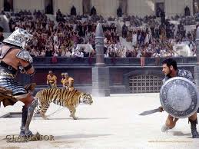
Roman Morality

Slide 38
Roman Morality
Divorce
Common in upper levels of society
Pompey married five times; Julius Caesar four times
No woman need blush to break up her marriage since the most distinguished ladies have adopted the practice of reckoning the year not by the names of the consuls but by the names of their husbands. They divorce in order to remarry. They marry in order to divorce (Seneca).

Slide 39
Roman Morality
Divorce
The church condemned divorce and took a strong stand for the permanence of marriage
Tertullian, the church father, said
Divorce these days is a religious vow, as if the proper offspring of marriage.

Slide 40
Roman Morality
Sexual Immorality
Fornication was so widespread as to be considered the norm
Demosthenes, the famous orator, wrote
Mistresses we keep for the sake of pleasure, concubines for the daily care of the body, but wives to bear us legitimate children.

Slide 41
Roman Morality
Sexual Immorality
Adultery was so common that Augustus, one of the best emperors, passed laws against it: a man who caught someone with his wife had the right to kill him
Wife-swapping was common

Slide 42
Roman Morality
One in mind and soul, we do not hesitate to share our earthly goods with one another. All things are common among us but our wives. We give up our community where it is practiced alone by others.
Tertullian, c. 200

Slide 43
Roman Morality
Sexual Immorality
Homosexuality, while frowned upon publicly, was quite common
The early Christians constantly condemn homosexuality and effeminacy in their writings (echoing the NT – Rom 1:26-27; 1 Cor 6:9-10)

Slide 44
Roman Morality
Infanticide
Many unwanted babies
Loose morals
Early marriage ages (girls normally married at 12, boys at 14)
Lack of contraceptive methods
Infanticide very common
Abortion
Exposure

Slide 45
Roman Morality
Exposure
Because of the dangers of abortion, the more common practice was exposing children
Undesired children deposited on the town rubbish heap
Slave market
A famous doctor of the second century, Soranus of Ephesus, wrote a book entitled, How to Recognize the Newborn Child That Is Worth Rearing

Slide 46
Roman Morality
Exposure
A chillingly routine letter has been found from a husband to his wife, 1 BC
I beg and entreat you, take care of the little one, and as soon as we receive our pay I will send it up to you. If by chance you bear a child, if it is a boy, let it be, if it is a girl, cast it out.

Slide 47
Roman Morality
Abortion
Abortion was also common
Some sources even suggest that women obtained abortions in order to retain their beauty
These practices were strongly condemned by the early Church
Thou shalt not murder a child by abortion nor kill them when born
Didache 2, 2nd century

Slide 48
Roman Morality
To hinder a birth is merely a speedier mankilling; nor does it matter whether you take away a life that is born, or destroy one that is coming to the birth. That is a man which is going to be one
Tertullian, Apology, early 3rd century

Slide 49
Roman Morality
The woman who purposely destroys her unborn child is guilty of murder. With us there is no nice enquiry as to its being formed or unformed. …
Women also who administer drugs to cause abortion, as well as those who take poisons to destroy unborn children, are murderesses
Basil of Caesarea, Letter 188, 4th century

Slide 50
Roman Morality
Leisure Activities
Theater quite popular in Greece and Rome
Some quality plays were written
Vast majority so depraved that actresses were classed with prostitutes
Christians constantly warned against the theaters in their works

Slide 51
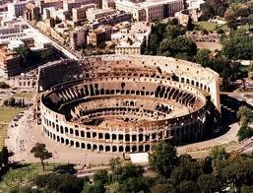
Roman Morality
Leisure Activities
Sports crazy
Coliseum in Rome was the scene of the violent contests spoken of earlier
It could be flooded so that naval battles could be staged.

Slide 52
Roman Morality
Leisure Activities
Most popular sports were the chariot races at the Circus Maxima
Four corporations, the Whites, Greens, Blues, and Reds, sponsored the chariots
Drivers were heroes and amassed huge fortunes
Teachers complained that during the races they could not keep their students’ attention because of the noise of the crowd

Slide 53
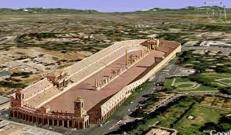
Roman Morality
“A hundred lawyers hardly make as much as that Red race-driver, ‘The Lizard’”
Juvenal, 2nd century Roman poet

Slide 54
Roman Morality
Crime
Urban crime common
Army patrolled roads
Inns dangerous
Robbery common
Police and fire department the same group of men
Too sparse for either job

Slide 55
Roman Morality
Crime
In Rome itself, muggings were common
The following are lines from a poem by the satirical Latin lyricist, Juvenal (2nd century)

Slide 56
Roman Morality
Here is how it all starts, the fight, if you think it is fighting
When he throws all the punches, and all I do is absorb them.
He stops. He tells me to stop. I stop. I have to obey him.
What can you do when he’s mad and bigger and stronger than you are?

Slide 57
Roman Morality
If you try to talk back, or sneak away without speaking,
All the same thing: you’re assaulted, and then put under a bail bond for committing assault.
This is a poor man’s freedom.
Beaten, cut up by fists, he begs and implores his assailant,
Please, for a chance to go home with a few teeth left in his mouth.

Slide 58
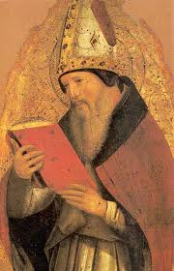
Roman Morality
Summary Principle
Augustine, in The City of God, contrasts Christian morality, which relates to the heart, and Roman public morality

Slide 59
Roman Morality
The laws should punish offenses against another’s property, not offenses against a man’s own personal character. No one should be brought to trial except for an offense, or threat of offense, against another’s property, house, or person; but anyone should be free to do as he likes about his own, or with his own, or with others, if they consent.

Slide 60
Roman Morality
There should be a plentiful supply of public prostitutes, for the benefit of all those who prefer them, and especially for those who cannot keep private mistresses. It is a good thing to have imposing houses luxuriously furnished, where lavish banquets can be held, where people can, if they like, spend night and day in debauchery, and eat and drink till they are sick:

Slide 61
Roman Morality
to have the din of dancing everywhere, and theatres full of fevered shouts of degenerate pleasure and of every kind of cruel and degraded indulgence. Anyone who disapproves of this kind of happiness should rank as a public enemy: anyone who attempts to change it or get rid of it should be hustled out of hearing by the freedom-loving majority.

Slide 62
Roman Morality
Misleading to suggest that God prepared the wickedness of the Greco-Roman world so that the light of the Gospel would shine out most brightly
The world into which Christ came, however, was a world experiencing tremendous human achievement in the arts, sciences, and philosophy

Slide 63
Roman Morality
Nevertheless, man’s greatest strides resulted in widespread depravity and misery
God gave man over to the natural bent of his depraved mind and then intervened in decisive fashion

Slide 64
Lessons

Slide 65
lessons
God is sovereign
Psalm 115:3
But our God is in the heavens:
he hath done whatsoever he hath pleased.
God’s Providence is comprehensive
Scriptural evidence immense
Cf. Layton Talbert, Not By Chance

Slide 66
lessons
What does the Fullness of Time entail?
Mind-boggling management of endless details
Human decisions – great and small
Sinful decisions
Situations centuries in the making

Slide 67
lessons
These truths apply personally
Paul intended this application
Galatians 4:4-7
When did slaves become sons?
Historically, at Incarnation
Twofold purpose: to redeem and adopt
Personally, at conversion
See 3:19, 23, 25

Slide 68
lessons
In my life, the fullness of time, as it were, came in 1970
How about you?

