Slide 1
Singing of the Risen Christ
Easter Hymn Histories

Slide 2
Christ Arose!
Robert Lowry
1874

Slide 3
Pastor
Lowry
Born in Philadelphia, 1826
Baptist pastor, 1854-1899
Pastorates in Pennsylvania, New York, New Jersey
Educator
Professor of Rhetoric, University of Lewisburg (now, Bucknell)
Eventually, Chancellor of the school

Slide 4
Hymnwriter
Musician
Hymnals editor for leading publisher of hymnals in America from 1868
Succeeded William Bradbury upon the latter’s death
Oversaw publication of over 20 hymnals
Wrote hymns
“Many of his hymns were written after the Sunday evening service, when his body was weary but his mind refused to rest.” (Sankey)

Slide 5
Hymns
“All the Way My Savior Leads Me” (music; lyrics – Crosby)
“Follow On” (music; lyrics – Cushing)
“I Need Thee Every Hour” (music and refrain; lyrics – Hawks)
“Nothing But the Blood”
“Shall We Gather at the River”
“Something for Thee” (music; lyrics – Phelps)
“We’re Marching to Zion” (music and refrain; lyrics – Watts)

Slide 6
Easter
Easter season, 1874
Meditating on Luke 24:6-8
“Why do you seek the living among the dead? He is not here, but is risen!”
Wrote hymn at pump organ in his home

Slide 7
Christ Arose!
Low in the grave he lay, Jesus my Savior, waiting the coming day, Jesus my Lord!
Vainly they watch his bed, Jesus my Savior, vainly they seal the dead, Jesus my Lord!
Death cannot keep its prey, Jesus my Savior; he tore the bars away, Jesus my Lord!
Up from the grave he arose; with a mighty triumph o’er his foes; he arose a victor from the dark domain, and he lives forever, with his saints to reign. He arose! He arose!
Hallelujah! Christ arose!

Slide 8
I Will Sing of My Redeemer
P. P. Bliss
1876

Slide 9
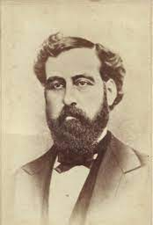
Preparation
Born July 9, 1838 in Hollywood, Pennsylvania (near Philadelphia)
Log cabin
Godly parents
“Home-schooled”
Heard piano at age 10
Fell in love with music

Slide 10
Preparation
Education
In and out of schools while working from age 11
Teacher certificate by age 17
Music
Met J. G. Towner in 1857
Voice training
William Bradbury in 1858
Encouragement to pursue music fulltime

Slide 11
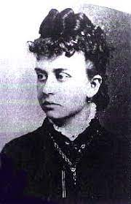
Preparation
Marriage
Lucy Young, June 1, 1859
Musical
Duets
Presbyterian

Slide 12
Ministry
Itinerant Music Teacher, 1860
Lucy’s encouragement!
Town to town with melodeon (portable keyboard)
Holding “singing schools”
Chicago, 1864
Music performer and teacher
Began writing gospel songs

Slide 13
Ministry
Root and Cady Musical Publishers 1865-1873
Popular songwriter
Musical conventions
Concerts
Teacher
Church
Music director and SS Superintendent, Presbyterian church in Chicago

Slide 14
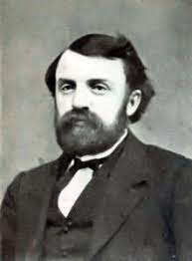
Ministry
Met D. L. Moody, 1869
Urged to fulltime ministry
“In my estimate, he was the most highly honored of God of any man of his time as a writer and singer of gospel songs, and with all his gifts he was the most humble man I ever knew. I loved him as a brother.”

Slide 15
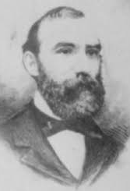
Ministry
Fulltime 1874
Song leader for Daniel W. Whittle
Major Whittle and Bliss
Whittle inspired “Hold the Fort”
1874-1876

Slide 16
Hymns
“Almost Persuaded”
“Dare to Be a Daniel”
“Hallelujah, ‘Tis Done!”
“Hallelujah, What a Savior!”
“Hold the Fort”
“I Gave My Life for Thee” (music; lyrics - Spafford)
“It Is Well with My Soul” (music; lyrics - Havergal)
“Jesus Loves Even Me”
“Let the Lower Lights Be Burning”
“My Redeemer” (lyrics; music – McGranahan)
“The Light of the World Is Jesus”
“Once for All!”
“Whosoever Will”
“Wonderful Words of Life”

Slide 17
The End
Christmas break, end of 1876
Tired after whirlwind tour with Whittle
Just composed tune for “It Is Well with My Soul”
Spent Christmas with Bliss family in Pennsylvania
Chicago
Invitation to sing at Moody’s Tabernacle at last Sunday service of the year
Left children with grandparents
Took train, Pacific Express, west

Slide 18
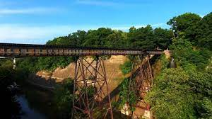
The End
Disaster
Trestle bridge over chasm near Ashtabula, Ohio
Engine reached solid ground on far side
Other cars plunged 75 feet into ravine
Philip survived, crawling out through window
Fire broke out – Lucy was still inside
“If I cannot save her, I will perish with her” – and he returned to the fiery car
Both died – he was 38

Slide 19
The End
Legacy
Trunk arrived in Chicago
Final hymns found inside
One of them was “I Will Sing of My Redeemer”

Slide 20
I Will Sing of My Redeemer
I will sing of my Redeemer and his wondrous love to me; on the cruel cross he suffered, from the curse to set me free. Sing, O sing of my Redeemer! With his blood he purchased me; on the cross he sealed my pardon, paid the debt, and made me free.
I will tell the wondrous story, how my lost estate to save, in his boundless love and mercy, he the ransom freely gave. I will praise my dear Redeemer, his triumphant power I’ll tell: how the victory he gives me over sin and death and hell.

Slide 21
I Will Sing of My Redeemer
I will sing of my Redeemer and his heavenly love for me; he from death to life has brought me, Son of God, with him to be. Sing, O sing of my Redeemer! With his blood he purchased me; on the cross he sealed my pardon, paid the debt, and made me free.

Slide 22
At Calvary
William R. Newell
1895

Slide 23
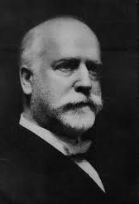
MBI
R. A. Torrey, Superintendent of Moody Bible Institute, Chicago
Letter from distressed father
Please admit my son, Bill, who is breaking my heart
Not a reformatory, a Bible college
Persistent and insistent

Slide 24
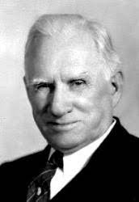
MBI
God’s will
Torrey relented
Conditions: daily sessions with Torrey, obedience to the rules
Success?
Not at first
He was listening
Converted
Graduated
Became professor

Slide 25
Testimony
How to Record Testimony?
Pondered for several weeks
Inspiration during class day
Jotted words on envelope on the way to a lecture
Daniel Towner
Director of MBI music
Melody?
Inspired
Tune ready by the end of the lecture!

Slide 26
Testimony
“Bill, I was so taken with the poem you gave me that I went immediately to my studio and composed a tune. I feel that it could be the best song that either of us will ever write in our lifetime.”
Sang it together
Published it shortly thereafter, 1895

Slide 27
Ministry
Bill Newell
Well-known Bible teacher across the Midwest
Author of popular commentary series
Believed troubled years helped him understand Calvary’s grace

Slide 28
At Calvary
Years I spent in vanity and pride, Caring not my Lord was crucified, Knowing not it was for me He died on Calvary.
By God’s Word at last my sin I learned– Then I trembled at the Law I’d spurned, Till my guilty soul imploring turned to Calvary.
Now I’ve giv’n to Jesus ev’rything, Now I gladly own Him as my King, Now my raptured soul can only sing of Calvary.
O the love that drew salvation’s plan! O the grace that brought it down to man! O the mighty gulf that God did span at Calvary.

Slide 29
At Calvary
Mercy there was great and grace was free, Pardon there was multiplied to me, There my burdened soul found liberty– At Calvary.

Slide 30
He Lives
Alfred Ackley
1932

Slide 31
Background
Ackley
Methodist family
Dad was a pastor and gifted in music
Taught to love God and music
Training
Specialized in cello
Studied harmony and composition in New York and London
Called to Preach
Pastor and Song Writer

Slide 32
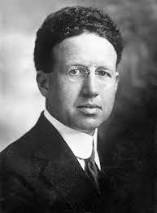
Inspiration
Easter Sunday, 1932
Listening to radio while shaving
“Good morning! It’s Easter! You know folks, it really doesn’t make any difference to me if Christ be risen or not. As far as I am concerned his body could be as dust in some Palestinian tomb. The main thing is, his truth goes marching on!”
Arch-Liberal Harry Emerson Fosdick

Slide 33
Inspiration
“It’s a lie!”
“Why are you shouting so early in the morning?”
Preached in a new way that day
“Listen here, Alfred Ackley, it’s time you did that which you can do best. Why don’t you write a song about it and then maybe you’ll feel better. You’ll have something that will go on telling the story.”
That evening he did so

Slide 34
He Lives
I serve a risen Saviour, He’s in the world today I know that He is living, whatever men may say I see His hand of mercy, I hear His voice of cheer And just the time I need Him He’s always near
In all the world around me I see His loving care And though my heart grows weary I never will despair I know that He is leading, through all the stormy blast The day of His appearing will come at last

Slide 35
He Lives
Rejoice, rejoice, O Christian Lift up your voice and sing Eternal hallelujahs to Jesus Christ, the King The Hope of all who seek Him, the Help of all who find None other is so loving, so good and kind
He lives, He lives, Christ Jesus lives today He walks with me and talks with me Along life's narrow way He lives, He lives, Salvation to impart You ask me how I know He lives? He lives within my heart

