Slide 1
John Mason Peck
The Man with Twenty Hands

Slide 2
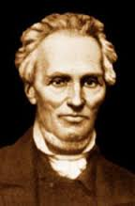

Slide 3
Part 1
Saved and Sent
1789 - 1826

Slide 4
An Unexpected Calling
1789 – 1813
(To Age 24)

Slide 5
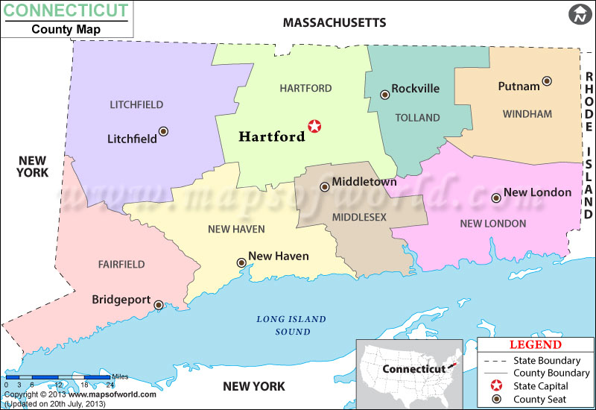
A New England Farmer
Born in Litchfield, CT – Oct 31, 1789
Parents, Asa and Hannah, were Congregationalists
“Baptized” as an infant

Slide 6
A New England Farmer
Worked the farm from a young age
Dad was an invalid
Grammar school education
Struggled with grammer grammar

Slide 7
Conversion
Revival meeting 3 miles from home
Second Great Awakening
Conviction
Converted, age 18
Dec 15, 1807
“The total depravity of the human heart was a doctrine I was early acquainted with. I felt a pleasure, therefore, in ascribing the whole work of salvation to the Lord, being sensible of my own weakness and my absolute dependence on divine grace.”
Notes:
Conviction over a week of meetings

Slide 8
Called to Preach?
Obstacles
Needed on the farm
Education required by religious establishment
Married Sarah on May 8, 1809 (godly woman)
Son Eli Prince born July 28, 1810 (1st son/1)

Slide 9
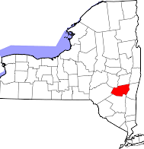
Called to Preach?
Questioned pedo-baptism
Unconvinced by Lyman Beecher
Windham, Greene County, NY
Joined community of farmers
Sought out Baptists

Slide 10
Called to Preach?
Baptized Sept 13, 1811 and joined New Durham Baptist Church
“Improving his gift”
First sermon: Mark 16:15 – the Great Commission
Preached in surrounding areas, including Catskill

Slide 11
Called to Preach?
Pastor Peck
Pastor at Catskill – no salary
Weekly offering – about $1/week
Daughter Hannah born July 10, 1812 (1st daughter/2)
Ordained to preach June 9, 1813
Notes:
Preaching in surround areas, supplementing income
Mentored by pastors in the area

Slide 12
Called to Preach
Struggled with “seasons of darkness and depression”
Feelings of inadequacy
Overworked, underpaid, growing family
“Better prepared to minister successfully to the spiritual maladies, or the morbid imaginations of others” (Babcock)

Slide 13
Turning West
1813 – 1817
(Ages 24 – 28)

Slide 14
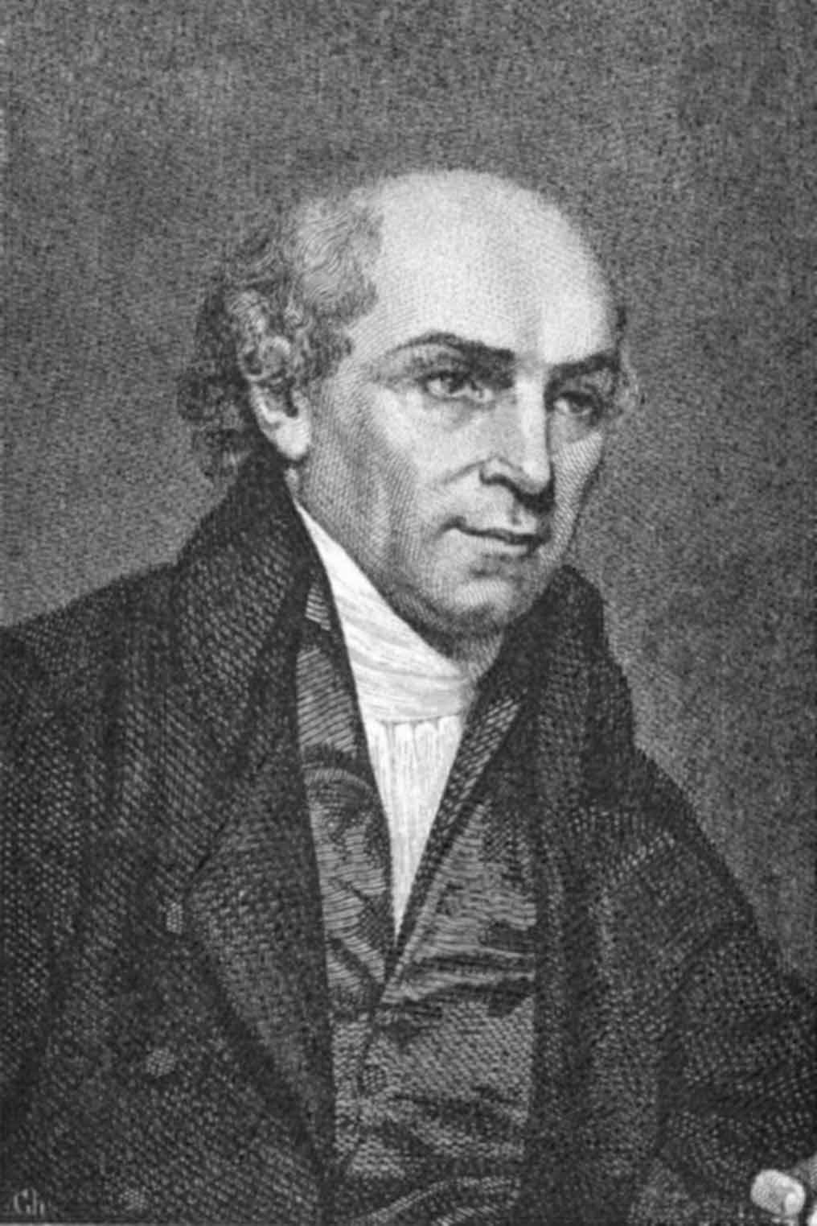
Faithful Service
Reading about William Carey
Longing for missionary service
“But alas, how idle and vain are my thoughts! In this place I am too faithless, too prone to wander. Oh, that I might first learn to perform the duties which come within my reach, and not presume to think I should be more faithful in another part of the vineyard!”

Slide 15
Faithful Service
Growing usefulness in the region
Compromised his health – nearly died
Resigned Catskill and took pastorate in Amenia, NY, Feb 19, 1814
Son Hervey born, Sept 28, 1814 (2nd son/3)
Notes:
Clerk of the Baptist Association in Greene County (24 years old)
Started night school to help with bills

Slide 16
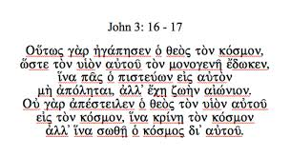
Faithful Service
Cold church, with discipline problems
Slow in paying his salary
Studied Greek with brother pastor

Slide 17
Missions?
Met Luther Rice (1783-1836)
Agent for missions in western NY
“Rode four hundred and forty miles, preached nineteen times, and took five missionary collections” (Babcock)

Slide 18
Faithful Service
Burdened for missions
Pull – strong desire to go
Push
Amenia church failing to pay his salary
Again opened school to supplement income
Again saw health beginning to fail
Resigned church at end of 1815

Slide 19
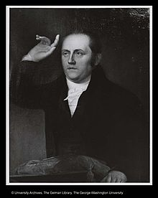
Training
Urged to western missions by Rice
Philadelphia for training in missions under Dr. William Staughton
Added Hebrew, Latin, and general studies to his Greek
Worked tirelessly in Staughton’s church
Notes:
Supported by Baptist mission fund
Left Sarah and their three children in NY

Slide 20
Missionary
Second meeting of Triennial Convention – 1817
Sansom Street Baptist Church
Missions committee endorsed Rice’s plan for a western mission
Peck and James Welch – missionaries to Missouri Territory

Slide 21
Missionary
“It is a solemn consideration. I have now put my hand to the plow. O Lord, may I never turn back—never regret this step. It is my desire to live, to labor, to die as a kind of pioneer in advancing the gospel.”

Slide 22
Early Labors
1817 – 1819
(Ages 28 – 30)

Slide 23
St. Louis
July 25, 1817
1200-mile journey – one-horse wagon and long voyage down Ohio River
Arrived in St. Louis on Dec 1 with wrecked health
2-month recovery
Joined there by Welch family

Slide 24
St. Louis
Initial efforts
School
First Baptist Church – first evangelical church in St. Louis
Sunday School for negroes – started with 14, grew to over 100
Baptized first converts in the Mississippi River
Notes:
Began making plans for a seminary for the West

Slide 25
Illinois
Extended ministry into Southern Illinois
“At the period of our visit, there were three parties of Baptists in Illinois that had about the same fraternal intercourse with each other as the Jews and Samaritans of the old time.”
The more things change …

Slide 26
Illinois
Dangerous travel across great barren or Indian-infested areas
“If you have a piece of jerked venison, and a bit of pone with a cup of water, you may make out a splendid supper, provided you think so; ‘for as a man thinketh, so is he.’”

Slide 27
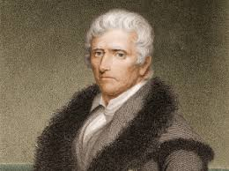
Highlights
In his 80s
Boones were KY Baptists
Chatted for several hours
Preached with Boone in attendance
Daniel Boone (1734-1820)
Notes:
Impressed by Boone’s cordiality and simplicity

Slide 28
Highlights
William Carey Peck, Feb 11, 1818 (3rd son/4)
United Society for the Spread of the Gospel
Missouri Bible Society (American Bible Society)
Mite Societies – raising funds for missions
All of these began in 1818
Notes:
USSG set up
Education Fund
Indian Fund
Mission Fund

Slide 29
Opposition
Widespread opposition to missions among frontier Baptists
Hyper-Calvinism
Opposition to “means” as non-NT innovations
Ignorance – threatened by more learned ministers
Defense of home turf

Slide 30
Opposition
“A set of crude and erroneous notions had been stereotyped in their minds, in Kentucky, about gospel doctrine and moral obligation, and they were fixedly resolved to learn nothing else. … For several successive years we met those brethren at associations, when they took a bolder and more decided stand against all organized efforts to publish the glad tidings to a sin-ruined world.
Notes:
Peck in 1817

Slide 31
Opposition
“They maintained that missions, Sunday-schools, Bible societies, and such-like facilities, were all men’s contrivances, to take God’s work out of his own hands. Their views of the plan of salvation through Christ were exceeding limited and imperfect, and their success was quite as limited as their Biblical knowledge was deficient.”

Slide 32
Opposition
“In many minds crude antinomian notions were intermingled with scattered and detached fragments of gospel truth. They had no clear and correct notions of the connection of Divine purposes and means to accomplish them. Because God worked in us to will and to do his own pleasure, they had no conception of human duty and responsibility. There was a mulish obstinacy about some of these men, as there is about the same class now. They would not examine the subject, candidly and prayerfully; they shut their own eyes against the light, and as far as in their power kept the members of their churches in darkness.
Notes:
Peck in 1818

Slide 33
Opposition
“They made the singular blunder in denying the use of all means and instrumentalities in the conversion of sinners and sending the gospel to the destitute, while they were active and zealous in using means and trying to be instrumental in opposing gospel measures. A third cause of this anti-mission spirit and practice among a class of preachers, originated in sheer selfishness. They knew their own deficiencies when contrasted with others, but instead of rejoicing that the Lord had provided better gifts to promote his cause, they felt the irritability of wounded pride, common to narrow and weak minds.”

Slide 34
Opposition
“A good English dictionary and a careful examination of the meaning of words, with a smattering of the elements of rhetoric, about ‘tropes and figures,’ and a slight touch of logic and mental philosophy would have been of great service to this class of preachers. But some of them were as much afraid of a dictionary as they were of a missionary.”
Notes:
Peck in 1819, describing some frontier preachers

Slide 35
Opposition
“Thus was the singular spectacle presented of a party separating themselves from their brethren, denouncing and excluding them, on the pretense of greater piety and more exact conformity to New-Testament order, whose chief peculiarity consisted in their opposition to the Saviour’s mandate,
Notes:
Peck in 1825 about pastors who were organizing anti-missions societies in MO and IL

Slide 36
Opposition
“‘Go ye into all the world and preach the gospel to every creature’—evangelize all nations. It is vain to pretend that these ministers and churches were only opposing some (to them) objectionable methods of complying with the risen Saviour’s commission, for they did not prosecute any other method.”

Slide 37
Opposition
Peck’s Judaizers
As the Judaizers hounded Paul throughout his ministry,
Anti-mission, hard-shell, “primitive” Baptists opposed Peck his whole life

Slide 38
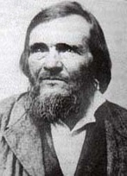
Opposition
Key leader: Daniel Parker (1781-1844)
Opposed Peck in IL and IN repeatedly
Attacked any ministry without direct warrant in the NT

Slide 39
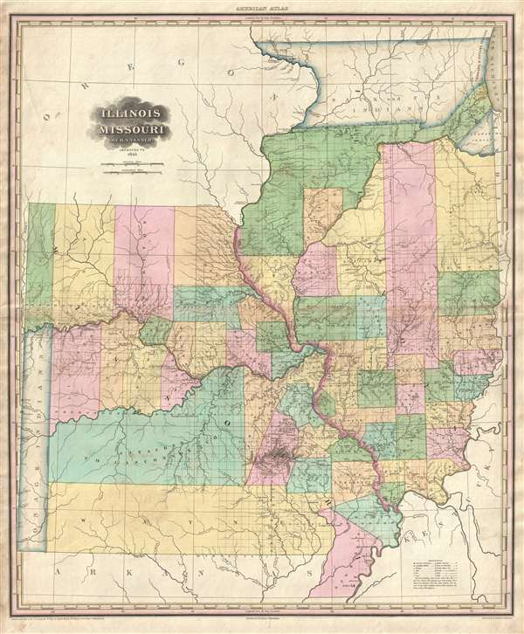
St. Louis
St. Charles, MO – 20 miles NW of St. Louis
Rock Spring, IL – 20 miles E of St. Louis
Alton, IL – 25 miles north of St. Louis

Slide 40
Trials in St. Charles
1819 – 1822
(Ages 30 – 33)

Slide 41
New HQ
St. Charles, MO in March 1819
Goal – mission station and seminary there
Welch’s remained in St. Louis
St. Charles Academy – 30 students within a month
Supplemented income
Contributed to raising regional literacy

Slide 42
Other Ministries
First Sunday School in St. Charles
Evening services for “colored people, chiefly slaves”
Saw steady conversions
Continued itinerant ministry
Evangelism, Bible distribution, and raising funds for missions (Mites)

Slide 43
Family Issues
Mary Ann born Sept 18, 1820 (2nd daughter/5)
Two weeks later
Eli (10 years old) died of a fever (Oct 5)
Almost exactly one year later
William Carey (3 years old) also passed away
Frontier life was hard

Slide 44
Cut Off
Board of Mission of Triennial Convention
Shut down St. Louis Mission in Oct 1820
Eli had just died
Directed Peck to join Indian Mission of Isaac McCoy at Fort Wayne, IN
Welch told to remain in St. Louis as pastor but without support

Slide 45
Cut Off
Peck strongly opposed this decision
Sarah’s health
Mary Ann a month old
Need in St. Louis area still great
Allowed to stay in MO, but without support

Slide 46
Surviving
Two very lean years
Farmed and ran a school to survive
Continued to pastor
Continued vigorous itinerant ministry

Slide 47
Surviving
Alternative missionary support agency
Massachusetts Baptist Missionary Society – March 1822
$5/week– enough to keep going

Slide 48
Expanding Ministry
1822 – 1835
(Ages 33 – 46)

Slide 49
Home
Rock Spring, IL in Apr 1822
Planted a church in May that was soon thriving
Home base for the remainder of his life and ministry
Postmaster
July 12, 1827 to Jan 12, 1850
Often managed by Sarah
Notes:
Rock Spring later swallowed up by O’Fallon, IL

Slide 50
Home
William Staughton was born Nov 13, 1823 (4th son/6)
Sarah almost died during the delivery
Peck was out preaching, learned of Sarah’s close call and met William in early 1824

Slide 51
Report
To the Massachusetts Baptist Missionary Society on Dec 31, 1822
“With sincerity of soul I can say there is no pursuit that affords such exquisite satisfaction as activity and success in measures to promote the gospel. I might dwell upon the difficulties attendant on an itinerating life—as absence from home, exposure to sickness, storms, cold, mud, swimming rivers, and not unfrequently rough fare—but these are trifles not worthy of one moment’s anxious concern. To live and labor for Him who died for the redemption of man is the highest favor which we need seek after in this transitory life.”

Slide 52
New Opportunities
Agent for the American Bible Society – Dec 1823
Great need for Bibles on the frontier
Anti-missions folks could hardly criticize Bible distribution
American SS Union begun in Philadelphia, 1824
Sunday Schools on frontier

Slide 53
Anti-Slavery
Battle in Illinois over Introduction of Slavery, 1823-24
Peck led the opposition
Slavery voted down on Aug 2, 1824
“Point to me the man who will not lift his voice against the trade of human souls and blood, and I pronounce that he neither loves his country nor his God. … So abhorrent from the sentiments of our nature is the practice of stealing humans, selling, and enslaving immortal souls, that it is difficult to describe and define this wretched degradation of man.”

Slide 54
Student of Scripture and Revival
Scripture
Read Scripture as he traveled between engagements
Difficult texts
Revival
Camp meetings of Methodists and Cumberland Presbyterians
Wild behavior often typical of these meetings
Notes:
Marked difficult texts with a pencil while traveling for further study at home

Slide 55
Revival
Peck, writing in 1824:
“All this excitement and effect, so far as visible, might have been produced without the agency of God, and might be and seemed to be only the effect of human causes,” and most of the results “proved false—worse than worthless.”

Slide 56
Opposition and Success
Opposition
By 1824 Parker had turned many churches in IL against Peck and missions
6 of the 8 or 9 associations were anti-missionary by 1830
Success
43 Bible societies and over 100 Sunday schools in IL and MO by Sept 1825

Slide 57
First Trip East
4,400-mile round trip (Feb 22 – Nov 3, 1825) – five key facets
Observed convention politics
Jonathan Going of Worcester, MA
Dad had passed away; brought mom home
Proposal to MA Baptist Mission Society for western evangelism
Notes:
Watched friends Rice and Staughton battle over convention versus society approach to ministry

Slide 58
First Trip East
Proposal had three aspects
System of circuit preaching for MO, IL, and IN
St. Louis as hub
Theological school in Illinois
Visited Columbian, Brown, Hamilton, and Newton to study the methods of instruction

Slide 59
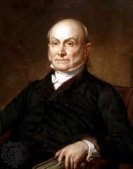
Follow-up to First Eastern Trip
John Quincy Adams Peck born Aug 27, 1825 (5th son/7)
Wrote Guide for Emigrants
Life in the West
Quintessential expert on western life and customs
Notes:
Peck met the president during this trip
Donated property in Rock Spring for seminary (needed $3000 to start school)

Slide 60
Second Trip East
To raise money for seminary (early 1826 – Nov 1826)
Raised 4/5 of the money needed
Dr. Shurtleff of Boston – $10,000 donation
“Shurtleff College”
Notes:
Attended Triennial Convention meetings
Attended Anti-Slavery Society, Tract Society, Bible Society, Colonization Society, and brand new Sunday School Union

Slide 61
Part 2
Evangelizing the West
1827 – 1858

Slide 62
Education
Rock Spring Theological and High School, opened fall 1827
Oversaw construction of several buildings
Hired Joshua Bradley as principal
Served as Professor of Theology
Sarah helped run the boarding school – a major sacrifice
First college in the state of Illinois

Slide 63
Growing Family
Last three children
Infant born Dec 10, 1827 – died without name (sex unknown/8)
Henry Martin born May 7, 1829 (6th son/9)
James Ashford born Sept 27, 1831 (7th son/10)
In 1832 the Pecks had
Five sons (18, 9, 7, 3, 1) and two daughters (20, 12)

Slide 64
Glimpse at Family Life
“See his cheerful helpmate, contenting herself as best she may to abide at home and assiduously care for the welfare of the family and guests, having never re-visited her native New England since her first departure in 1817. Nor can you fail to notice that daughter Mary, with the father’s energy, and the mother’s quietness: how steady, noiseless, and efficient are all her movements! and to her, in no small degree, are owing the comfort and happiness which always smile around that dwelling.
Notes:
Visitor’s testimony in 1844

Slide 65
Glimpse at Family Life
“We need say nothing of the sons, for the older ones were now absent, and of younger, half-grown men it is not quite fair to speak; for they are not yet what they soon will, be, or ought to be: but as their good, considerate mother said: ‘They do so much need their father with them.’ Still, we can truthfully testify to the kind-hearted ingenuousness which they uniformly evinced. May they one day prove their parents’ crown of rejoicing!”

Slide 66
Publishing
Friend set up printing press in Rock Spring in 1828
With help from a donor, Peck launched the Pioneer
First issue published in April 1829
Very successful religious periodical
Peck edited it and wrote many of the articles
Continued this responsibility until he sold it in Jan 1839

Slide 67
Publishing
Added other writing outlets
Monthly journal that targeted Baptists
Half-sheet devoted to advancing Sunday Schools
Periodic updates to his Guide for Emigrants
A gazetteer of Illinois that was “much fuller and more accurate” than any existing maps
An expose of Mormonism (1835)

Slide 68
Publishing
A biography of Daniel Boone (1845)
A multi-volume history of the settlement of Illinois
Numerous articles on various subjects for periodicals in both the West and the East
Astonishing productivity

Slide 69
Western Survey Trip
In 1831 traveled with Jonathan Going across MO, IN, IL, and KY
American Baptist Home Mission Society in 1832
Director of all western missions
Notes:
Attended conferences, camp meetings, and every other gathering of Baptists
Framed together a plan for the evangelization of the West

Slide 70
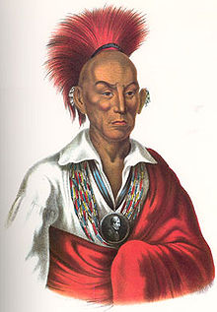
Troubles
Black Hawk War 1831-33
Travel more dangerous
Ministered to families in harm’s way
Published support for the war effort
Lamented widespread unconcern for Indian spiritual welfare

Slide 71
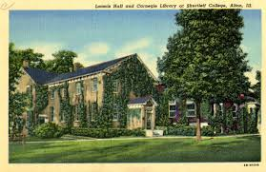
Focusing on the Seminary
Moved the seminary to Upper Alton, IL in 1834
First Baptist college west of the Appalachians
Renamed Shurtleff College in 1836
Swallowed up by Southern Illinois University in 1957

Slide 72
Focusing on the Seminary
“The affairs of the seminary (a charter of it as a college was about this time obtained) caused him very frequent visits to its locality at Upper Alton. To secure in an economical and efficient manner the requisite buildings, to harmonize teachers young and old from New England and from Old England, as well as some raised up on the ground, to watch over and procure in tolerable season the scanty finances derived chiefly from small subscriptions, and to give as much efficiency and reputation as possible to the young and unendowed institution, required of him, with all his other cares and toils, much more of effort than he was really able to put forth” (Babcock).

Slide 73
“Slowing Down”
1835 – 1845
(Ages 46 – 56)

Slide 74
Health
Health Issues
Recurring illnesses – chills, fevers, stomach problems, etc.
In 1836 resolved to slow down
Resigned as superintendent of western branch of Sunday School Union
Began to cut back his writing ministry
Devoted himself to seminary and local preaching

Slide 75
Blessings
Conversions
Several of his sons were saved during this time
Saw many softened hearts in wake of Black Hawk War
“Scarce a sermon have I delivered of late which God has not blessed in the conversion of souls.”
Toured western IL and into IA, where God used him to bless many small pioneer communities

Slide 76
Blessings
Illinois
Helped to form the Illinois Education Society
Became even more active in Illinois Baptist Association annual meetings
Pastor
Baptist church of Rock Spring and Zoar in 1838
Revival in Rock Spring in 1839 – 22 conversions, including his son William
Notes:
Promised them ¼ of his time, until he could lighten his schedule, then ½

Slide 77
Traveling with Sarah
Midwestern tour with Sarah in 1839
“The whole journey above indicated was accomplished not without the usual accompaniment of such tours, sundry breakdowns, the loss of the right way in the woods and on the prairies, and specially many thorough wettings in the rains which were more than usually abundant for this season of the year.”
Notes:
Tour of IL into IN and up into MI, visiting a number of her relatives
First visit to Chicago

Slide 78
Slowing Down, Seriously
“After much serious reflection I have come to the conclusion that I must give up traveling and all missionary agency. I have now made trials for four seasons, and cannot sustain the fatigue, labor, and exposure. My liver is permanently affected, my constitution seriously impaired, and I must retire to a more quiet and sedentary life. There is field enough for me to occupy around me, and Divine Providence will in some way provide for me.”
Notes:
Diary entry at his 50th birthday in 1839

Slide 79
Slowing Down, Seriously
Gave up most of his ministries, sold his periodical, and settled down locally
Added pastorate of the Baptist church in nearby Belleville in addition to the church in Rock Spring and Zoar that he was already serving part-time
Slowing down involved taking on another local church pastorate!

Slide 80
Speeding Up
Western Baptist Convention meeting in Louisville 1840
Jonathan Going was president
Chair of the steering committee for western mission
Secretary of the Western Historical Society
Tasked with revising the western hymnal
Spent four weeks in Louisville

Slide 81
Speeding Up
General Secretary of the Western Baptist Association – Sept 24, 1841
“Various indications of Providence in opening my way and removing difficulties seem to point out the pathway of duty in this direction. Whether I can endure the exposure and fatigue necessarily involved, and sustain health, is to be tested by experience. My hopes are that by steamboat and stage traveling, by spending the winters South, and the summers North, and having comfortable houses to lodge in, I may keep up a few years longer. This certainly is the greatest and most responsible business I have ever undertaken. May the Good One direct and keep me, and allow me to fill up the balance of my life with usefulness.”

Slide 82
WBA Work
Resigned his pastorates
Moved to Louisville
Sarah remained at the homestead in Rock Spring
Elected president of Illinois Baptist Convention in Oct 1841
Defeat for the anti-missions forces in IL
Notes:
Found successors for several of the churches
Planned to spend a few months each year in Louisville

Slide 83
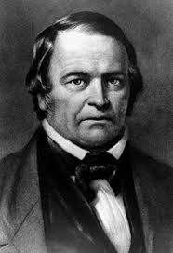
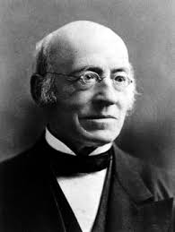
Third Trip East
On behalf of WBA (Apr – Nov 1842)
William Miller
William Lloyd Garrison
Temperance crusades
Preached in church where he was baptized
Notes:
Attended all the society anniversary meetings, preaching in Pittsburgh, Harrisburg, Philadelphia, and New York
Stunning array of meetings and conferences throughout New York and New England, presenting his work constantly, raising money, and preaching

Slide 84
Third Trip East
“To-day I attended for a few moments a sale in the market place. A negro boy was sold, who appeared about twelve years old. He stood by the auctioneer on the market-bench, with his hat off, crying and sobbing, his countenance a picture of woe. I know not the circumstances; but it was the first human being I ever saw set up for sale, and it filled me with indescribable emotions. … slavery in its best state is a violation of man’s nature and of the Christian law of love.”
Notes:
Visited Nashville on the way home

Slide 85
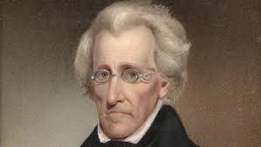
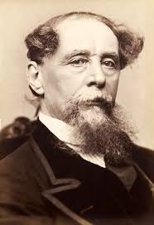
Southern Tour
Began 1843 with a tour of the South on behalf of the WBA
Andrew Jackson
Charles Dickens
Notes:
Peck gave him two of his books

Slide 86
New Opportunity
Secretary of the Baptist Publication Society in Philadelphia, 1843
Struggling organization
25% reduction of all salaries, including his own
Headed east to assume leadership in Mar 1843

Slide 87
Fourth Trip East
To Philadelphia: May 1843 – Jan 1844
Reorganized the Society
Launched plan for reading and literacy advocacy across the country
Lyman Beecher, John Leland, and Francis Wayland
Notes:
Thief stole all his pocket money during the trip

Slide 88
Fourth Trip East
“From May to December [1843] he preached seventy-eight times, delivered thirty other addresses, visited forty-five churches officially, four associations, five State conventions, six ministers’ meetings, one camp-meeting, and one college commencement, and traveled three thousand three hundred and ten miles, besides office-work enough to have fully engrossed an ordinary man. Such were his common experiences and efforts, for the whole period of his official connection with the society, varied and somewhat relieved by his annual visit to Rock Spring” (Babcock).

Slide 89
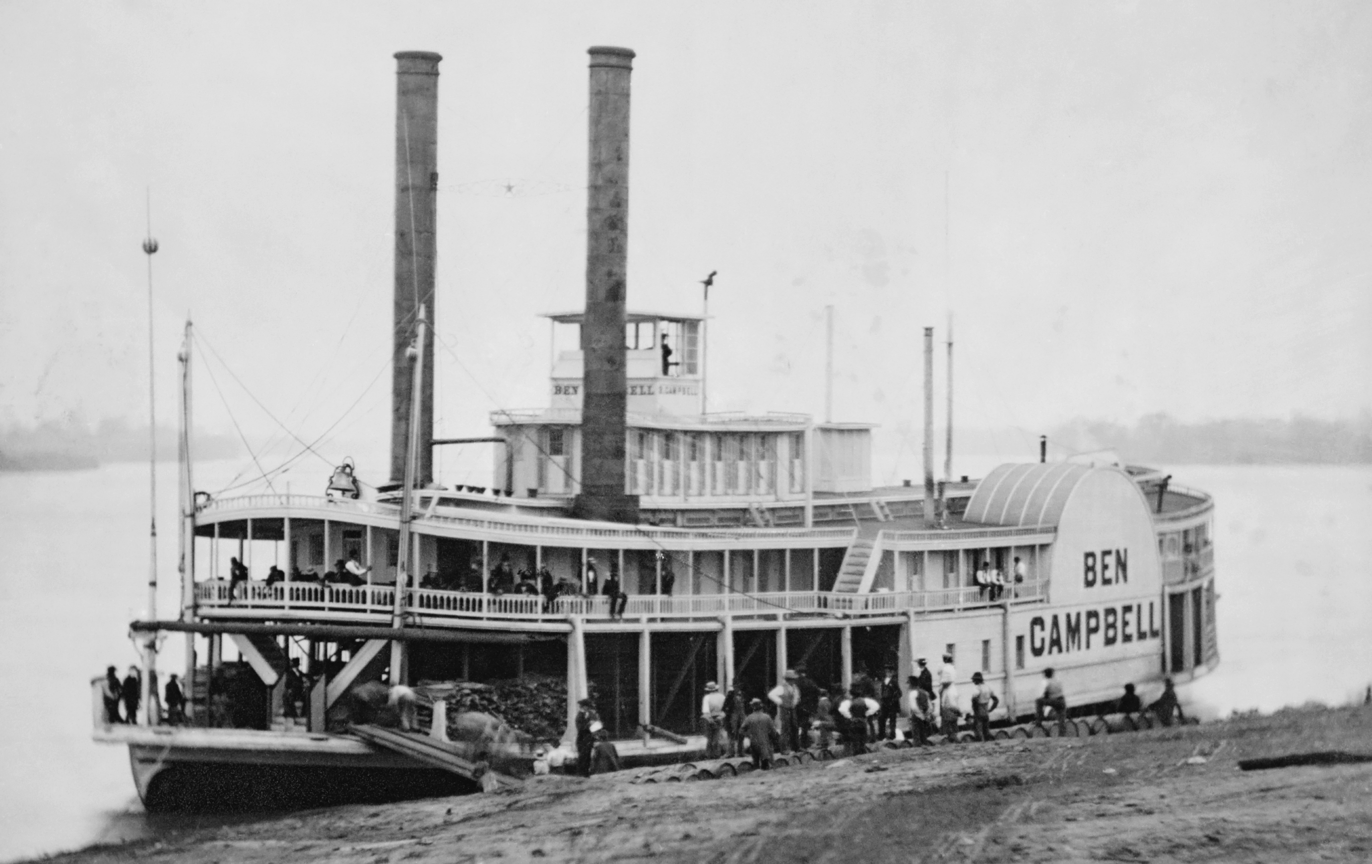
Fourth Trip East

Slide 90
Fourth Trip East
“Retired to my berth at about half-past nine, with my clothes on except my coat, the night being very cold. After considerable time I fell asleep. Near eleven o'clock I was awakened by a dreadful crash: the boat struck a large snag, scarcely above the surface of the water. This occurred a little below the mouth of Cahokia creek. I heard nearly at the same instant screams of distress, and sprang from my berth, put on my coat, seized one boot, but before I could put it on the water was rushing into my state-room, which was forward of the wheel-house.

Slide 91
Fourth Trip East
“Without boots or hat I rushed on to the guard, seized the projecting portion of the hurricane (or upper) deck, where, after considerable difficulty, I succeeded in getting on to that deck. A number of persons were already there, and many more got on from the stern afterward. The bow was so far under water as to cover the guards, but the stern held up some time longer. Hearing cries in the ladies’ cabin I got the pole of a wagon on the deck, and thrusting it in at the sky-light tried to pry off the roof, but found it impossible. The ladies, however, succeeded in getting on the hurricane deck, as did most of the steerage passengers.

Slide 92
Fourth Trip East
“The boat was then floating sideways down the current, and soon ran on another snag and careened partly over. This threw off the boilers, and the bow thus lightened, brought the guards to the surface. The hull of the boat then separated and floated alongside the cabin and upper works. Next the smoke stacks, or chimneys fell, which tore off the end of the hurricane deck. Captain Howell, with several other persons, was killed or knocked overboard by the fall of the chimneys. The wheel-houses were soon separated from the deck, and floated off or sunk.

Slide 93
Fourth Trip East
“Finding myself exposed to the piercing atmosphere, I got down on the guards. But before this I had prayed repeatedly with the people around me. At first there was much confusion, and many screams and howlings to God for mercy. Some professors of religion prayed consistently. While I was on the guard, and the hull of the boat was floating alongside, I got on the bow, and stood for some minutes, but not liking its movements I was induced to return to the guard again. Soon the hull struck a bluff-bar and turned nearly over. Several were on it, and were drowned.

Slide 94
Fourth Trip East
“Persons now gathered planks, doors, and pieces of the wreck to swim on. I looked about for something of the kind, but finally concluded to stick by the wreck while it floated. The hurricane deck fell after a while, caused I suppose by the weight of the people upon it. We were now on a sort of raft, formed by the cabin-floor and guards, which continued floating as the current bore us, first on one side, then in the middle, and then on the other side of the river. Some were entirely wet—men, women and children, with very little clothing on. They suffered intensely.

Slide 95
Fourth Trip East
“A steamer lay at the shot-tower, just above Videpoche, and as we passed near, we aroused the men on board, who came off in their yawl. As it neared the wreck, I directed them to pass around to the stern, and first relieve the women and children, who were perishing. They took on board their boat most of the ladies and children, and put them on shore. The next time the yawl came near the stern on my side. I had made up my mind—since I did not suffer as severely as some others—to give them the preference; but seeing a little girl quite helpless, I caught her up and leaped into the boat.

Slide 96
Fourth Trip East
“By this time we had floated a long distance down the current, and were landed a full mile below Videpoche, so that I had to walk without boots or shoes. My stockings were soon worn through. The ground was frozen hard, and its sharpness hurt me at every step. One foot was frozen about the ball, and very much cut. I carried, too, one of the babes of Mrs. Snell, a passenger. On reaching the first house they would not let us in. At the next we obtained shelter and refreshment.

Slide 97
Fourth Trip East
“Soon after a little girl was brought in by some men, entirely cold, speechless, senseless. I got a blanket, removed her wet and frozen garments, and rubbed her with flannels and vinegar. It was about an hour before she began to moan, and more than four hours before any warmth appeared, except about the heart. She so far recovered before I left the place as to speak. [Her name was Maria Pool, and some days after, in St. Louis, Mr. Peck received the grateful acknowledgments of her parents.]

Slide 98
Fourth Trip East
“A boy was brought in alive and I prescribed the same course for him, but he was suffered to die. Another girl was brought in dead. The yawl went four times to the wreck, and the ferry-boat Icelander helped to complete the work. Soon as daylight dawned I went to the store and bought a cap and shoes. Went also to the wreck in a steam tug sent down by the Mayor of St. Louis, found my large trunk with manuscripts and other materials, with overcoat, so that the pecuniary loss was but about thirty dollars.

Slide 99
Fourth Trip East
“At an early period, and when the boat was breaking up, I fully expected death, as I could not swim, but felt calm and resigned, no ecstasy and no fear, but perfect self-possession, with ability to think of, and care and pray for others. Eternity will never seem nearer till I enter it.”
Notes:
Though lamed by the event, Peck rushed home so his wife and children would see him before receiving news of the crash
Sympathy poured in from his friends around the country

Slide 100
Fourth Trip East
Peck’s conclusion:
“Blessed be God for his goodness to me. I consider myself under additional obligation, anew to devote myself unreservedly to his service.”
He spent 10 weeks at home recovering

Slide 101
Fifth Trip East
Returned to Philadelphia in Apr 1844
“Give attendance to reading”
Editing and publishing
Alexander Carson’s classic work on baptism
The works of the great Baptist theologian Andrew Fuller
Some of the works of British Baptist theologian Abraham Booth

Slide 102
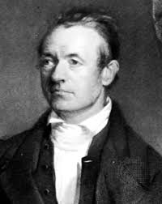
Sixth Trip East
On behalf of the Publication Society, 1845
Southern Baptists
Establishment of the SBC
Traveled extensively in NE (visited Maine), VA and NC
Attended final meeting of Triennial Convention
Constitution for new ABMU
Adoniram Judson
Notes:
Southern Baptist withdrawal created tremendous financial pressures
Southern brethren were polite but would not support northern ministries
Announced retirement as secretary of the Publication Society
Left the organization in a much stronger state

Slide 103
Final Ministries
1845 – 1858
(Ages 56 – 68)

Slide 104
Settling Down
Local work in the late 1840s
Part-time pastor or stated supply for Baptist churches in Troy, Edwardsville, Belleville, and Bethel
Interim pastor for 9 months in St. Louis (1849)
Pastor of Bethel Baptist Church, Bethel, IL (1849-52)
Notes:
All of which were relatively near Rock Spring
Until coming of Jeremiah Jeter as pastor

Slide 105
Trials
Fire destroyed most of the buildings at the Shurtleff College in 1852
Personal library – largest in the West – destroyed
Final trip east to raise money to rebuild
Stopping in Louisville, he presented a plan for a Baptist Historical Society
Received an honorary doctorate from Harvard University

Slide 106
Trials
Pastor of Covington Baptist Church, near Cincinnati, 1853
After just 3 ½ months, his health forced him to resign
His doctor told him he must give up full-time work
His son Hervey died Jan 17, 1856, age 41
Notes:
Continued to fill pulpit in area churches and to write

Slide 107
Trials
In Nov 1856, Sarah Peck passed away
“A Model Wife and Mother”
Peck wrote a tribute to Sarah in the April and May, 1857, issues of Baptist Family Magazine

Slide 108
Trials
“The wife I have loved was an extraordinary wife and mother, and I think, in justice to her memory, and as an illustration of my poor labors, I ought to devote one reminiscence to her, as a remarkable help-mate in all my labors and efforts. I have never thought it expedient and proper to write or speak in praise of my late dear wife while living;

Slide 109
Trials
“but now she has finished her course, it ought to be known in what sense, and to what extent she was the help-mate, pre-eminently, in every department of labor her husband undertook. I now assure all my friends that had not that woman possessed the principles, and been the wise, prudent, self-denying HEAD, and government of my family she was, I could not have made half the sacrifices, and performed half the services my kind friends have attributed to me.”
Notes:
Emphasis in the original

Slide 110
Final Trip
Western Trip (July – Sept 1857)
He traveled up the Mississippi as far as Galena
Saw children and grandchildren (most of whom lived in IA)
Entered Wisconsin and visited Madison
Visited Chicago where he was hosted by the mayor of the city

Slide 111
Final Final Trip
Health began to fail in early 1858
Peck passed away on Sunday, Mar 14, 1858
68 years old
Buried in St. Louis

Slide 112
Jeter on Peck’s Character
“Though he was a man of strong will, and loved, as earnest and energetic men are apt to do, to have his own way, yet I never discovered in him the signs of envy or of mortified ambition. He thought, of course, his own plans right, and struggled manfully to carry them out; but accorded to brethren differing from him sincerity and worthy motives. In all his plans for extending the kingdom of Christ—and they were numerous—and in all his warm controversies in supporting them, there was an almost perfect self-abnegation. …

Slide 113
Jeter on Peck’s Character
“Mr. Peck was a Western man. He removed to the West while young; and his tastes, manners, habits, and modes of thinking and speaking were formed there. No intelligent and observant man could be in his presence five minutes without perceiving unmistakable evidence of this truth. The pioneers were a hardy, self-denying, courageous, and independent class of men. For forms, etiquette, and pretensions they had no respect. They were practical, not theoretic.

Slide 114
Jeter on Peck’s Character
“Mr. Peck was not only a pioneer, but a master-spirit among the pioneers. Perhaps no man of the class did more than he to guide the thoughts, mold the manners, and form the institutions of the West. He was an embodiment of Western character—plain, frank, self-reliant, fearless, indomitable, with all his powers, physical and intellectual subordinated by grace to the service of Christ.”

Slide 115
Lessons from the Life of John Mason Peck

Slide 116
Lessons
“Only one life, will soon be past. Only what’s done for Christ will last.”
Jim Elliot’s words in the 20th century perfectly describe Peck’s motivation and urgency in the 19th
One of his favorite words was “useful”

Slide 117
Lessons
Christian ministry always involves teamwork
Peck’s life of sacrificial ministry would have been impossible without Sarah’s life of sacrificial ministry
His labors were not in vain in the Lord
Churches all across the Midwest, but especially southern IL and eastern MO, trace their origins back to Peck

Slide 119
When This Passing World Is Done
Lyrics: Robert Murray McCheyne, 1813-1843
Music: Richard Redhead, 1820-1901

Slide 120
“by grace ye are saved…that in the ages to come He might shew the exceeding riches of His grace in His kindness toward us through Christ Jesus.”
Ephesians 2:5, 7

Slide 121
When this passing world is done, When has sunk yon radiant sun, When I stand with Christ on high, Looking o’er life’s history, Then, Lord, shall I fully know— Not till then—how much I owe.

Slide 122
Chosen not for good in me, Wakened up from wrath to flee, Hidden in the Savior’s side, By the Spirit sanctified, Teach me, Lord, on earth to show, By my love, how much I owe.

Slide 123
When I stand before the throne, Dressed in beauty not my own, When I see Thee as Thou art, Love Thee with unsinning heart, Then Lord, shall I fully know— Not till then—how much I owe.

