Slide 1
Christian Science
2 Timothy 3:16
2 Peter 1:16-21
1 John 4:1-3

Slide 2
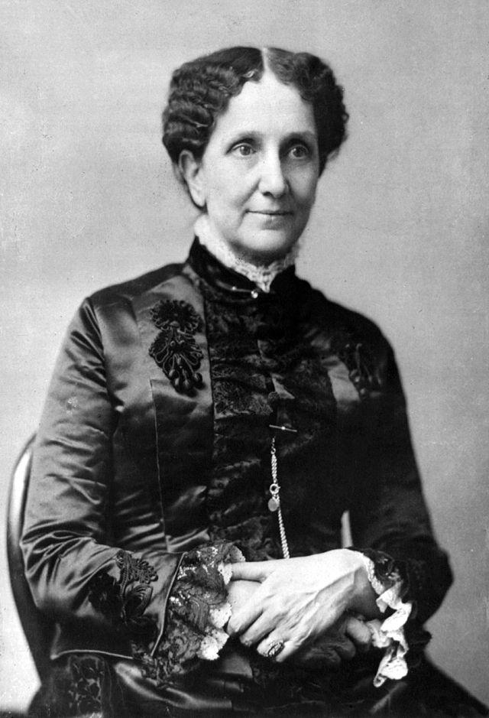
I. Historical Background
Started in 1879
The founder was Mary Baker Eddy
Born in New Hampshire in 1821
Father was a Congregationalist minister
Lived until 1910

Slide 3
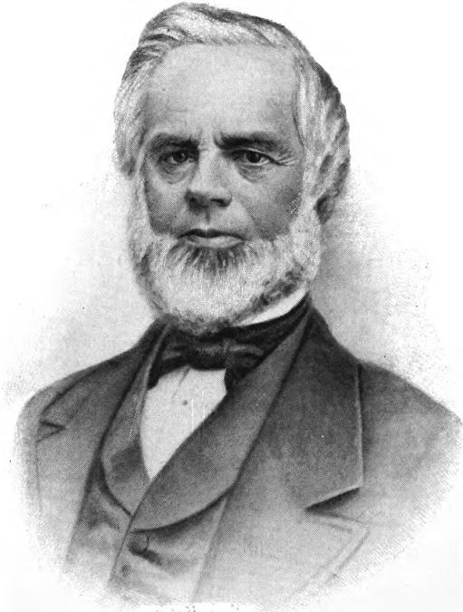
I. Historical Background (Early Years)
Mary was sickly and ill throughout her child
Her brother, Albert, died in 1841
Married George W. Glover in Dec 1843
7 months later, widowed and 6 mo. pregnant
Mother died in 1849
Three weeks after, her fiancé died
Her son (age 4) was sent away
Remarried to Daniel Patterson (1853)
Continually struggled with illness
Met Phineas Quimby in 1862

Slide 4
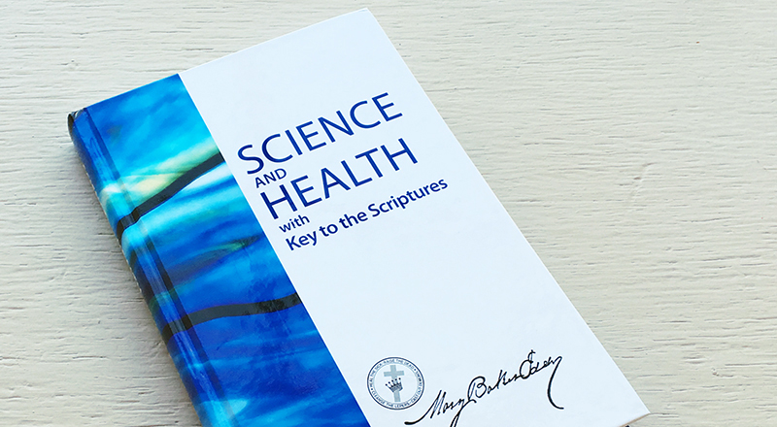
I. Historical Background (Later Years)
In 1866, a fall caused a fatal(?) injury from which she suddenly recovered from after reading Scripture
She began developing her theories of healing mixed together with her theology
Eddy and Patterson divorced (1873)
Published Science and Health (1875)

Slide 5
I. Historical Background (Later Years)
Married Asa Eddy (1877); Died 5 years later
1879: Organized the Church of Christ, Scientist
Opened a college in 1881
Died as a millionaire (1910)
Current Headquarters: Boston, MA; “The Mother Church”

Slide 6
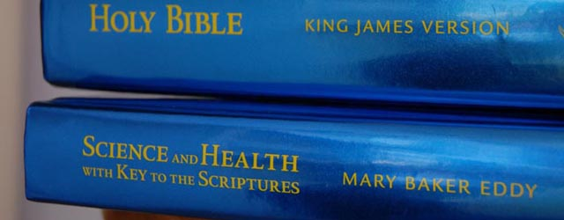
II. Authoritative Basis
Leader is Mary Baker Eddy even since her death – through her writings
Science and Health with Key to the Scriptures
The Bible – together are called the “Pastor”

Slide 7
II. Authoritative Basis
“It’s common for people to look to a pastor when they need guidance, comfort, healing, or a deeper sense of purpose. The Christian Science Pastor is available to offer this kind of nurturing and mentoring around the clock. That’s because the worldwide Church of Christ, Scientist has just one universal, permanent Pastor.
From Christian Science Website 11/6/2016

Slide 8
II. Authoritative Basis
“Mary Baker Eddy, who discovered and founded Christian Science, wanted her Church’s Pastor to be as pure, constant, and powerful as God’s Word itself. To this end, in 1895 she ordained as Pastor both the Bible and her book, Science and Health with Key to the Scriptures, which opens up the Bible in its application to all human needs. Together, these two books are a mentor, spiritual resource, and timeless guide open to all—a Pastor for the world.”
From Christian Science Website 11/6/2016

Slide 9
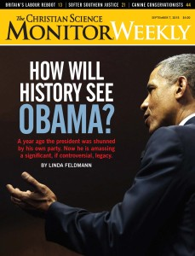
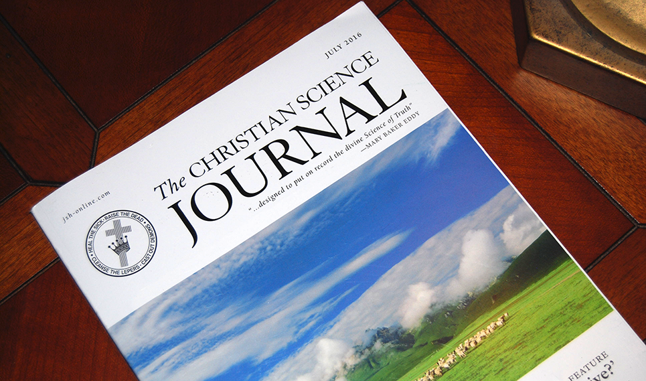
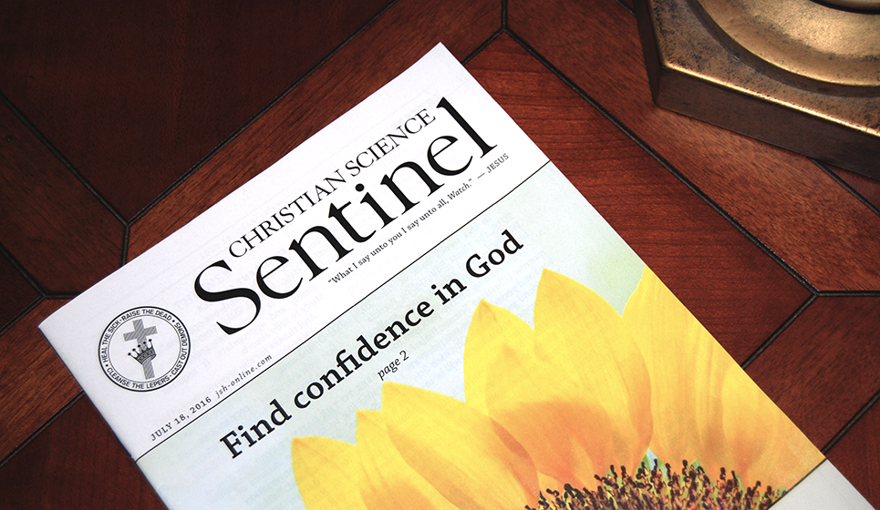
II. Authoritative Basis
Christian Science Monitor (Newspaper);
Christian Science Sentinel;
The Christian Science Journal

Slide 10
III. Beliefs and Teachings (Bible)
It is NOT inerrant
The Bible has many mistakes
Eddy considered herself the “key” for interpreting it
The “key of David” in Rev 3:7
The woman in Rev 12
“…the manifest mistakes in the ancient versions; the thirty thousand different readings in the Old Testament, and the three hundred thousand in the New – these facts show how a mortal and material sense stole into the divine record, with its own hue darkening, to some extent, the inspired pages.” (S&H, 139)

Slide 11
III. Beliefs and Teachings (Bible)
It is NOT inerrant
The Bible has many mistakes
Eddy considered herself the “key” for interpreting it
The “key of David” in Rev 3:7
The woman in Rev 12
“Referring to Genesis 2:7: Is this addition to His creation real or unreal? Is it the truth, or is it a lie concerning man and God? It must be a lie.” (S&H, 524)

Slide 12
III. Beliefs and Teachings (God/Trinity)
God is the “Father-Mother”
God is a “Divine (or Universal) Principle,” “Divine Mind”
Deny the personhood or personality of God;
The “Trinity” consists of Truth, Life, and Love
Belief in the traditional Trinity is polytheism
“The theory of three persons in one God (that is, a personal Trinity or Triunity) suggests polytheism, rather than the one ever-present I am.”
(S&H, 256)

Slide 13
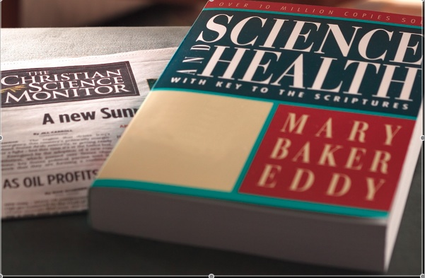
III. Beliefs and Teachings (Jesus Christ)
Deny that Jesus is God
The incarnation and bodily resurrection did not occur.
Jesus did not really die on the cross.
He was not God in flesh.
He made no atonement in shedding His blood

Slide 14
III. Beliefs and Teachings (Jesus Christ)
"Jesus Christ is not God, as Jesus himself declared . . . "
S&H 361:12-13.
“The spiritual Christ was infallible; Jesus, as material manhood, was not Christ.” (Miscellaneous Writiings, 84)
"If there had never existed such a person as the Galilean Prophet, it would make no difference to me." (The First Church of Christ Scientist and Miscellany, pp. 318, 319).
"The sacrifice of Jesus was not sufficient to cleanse from sin," S&H 25:6.

Slide 15
III. Beliefs and Teachings (Man)
There is no literal, physical existence of the material universe.
Man is God’s image and likeness
Man did not originate from dust, materially, but from Spirit, spiritually
"Life is not material or organic." S&H 83:21.

Slide 16
III. Beliefs and Teachings (Sin)
Devil, sin, death are illusions, don’t exist
Good and evil are not real
Matter and sickness are only illusions
“Sin, sickness, and death are to be classified as effects of error. Christ came to destroy the belief of sin.” (473)
“Hence, evil is but an illusion, and it has no real basis. Evil is a false belief, God is not its author.” (480)

Slide 17
III. Beliefs and Teachings (Sin)
"Matter, sin, and sickness are not real, but only illusions," S&H 335:7-15; 447:27-28.
“At best, matter is only a phenomenon of mortal mind, of which evil is the highest degree; but really there is no such thing as mortal mind – though we are compelled to use the phrase in the endeavor to express the underlying thought.” (Unity of God, 50)

Slide 18
III. Beliefs and Teachings (Salvation)
Salvation = finding the true reality of understanding – according to Christian Science
"One sacrifice, however great, is insufficient to pay the debt of sin. The atonement requires constant self-immolation (sacrifice) on the sinner’s part. That God’s wrath should be vented upon His beloved Son, is divinely unnatural. Such a theory is man-made" (S&H 23:3-7).
"True healings are the result of true belief," S&H 194:6.

Slide 19
III. Beliefs and Teachings
Opposed to the use of medical treatment
Christian Science Practitioners help people overcome their false realities of illness
Proper can help the “non-reality” of sickness
“If prayer nourishes the belief that sin is cancelled, and that man is made better by merely praying, prayer is an evil. He grow worse who continues in sin because he fancies himself forgiven.” (S&H, 4)

Slide 20
III. Beliefs and Teachings
“Theoretically, Eddy was an absolute idealist who denied outright the existence of matter from the tiniest insect to the most gigantic star in the celestial galaxies. But practically speaking, Eddy was a calculating materialist, an individual who thoroughly enjoyed all the material comforts derived from denying their existence. Hundreds of thousands of faithful Christian Scientists supplied their “leader” with all that money could buy and every material benefit available, yet eddy continually affirmed the nonexistence of these material blessings by teaching in effect that they really did not exist to be enjoyed – they were ‘illusions of mortal mind,’ she said.” (The Kingdom of the Cults, Walter Martin, p. 165)

Slide 21
Tenets of Christian Science
As adherents of Truth, we take the inspired Word of the Bible as our sufficient guide to eternal Life.
We acknowledge and adore one supreme and infinite God. We acknowledge His Son, one Christ; the Holy Ghost or divine Comforter; and man in God's image and likeness.
From Christian Science Website 10/31/2016

Slide 22
Tenets of Christian Science
We acknowledge God's forgiveness of sin in the destruction of sin and the spiritual understanding that casts out evil as unreal. But the belief in sin is punished so long as the belief lasts.
We acknowledge Jesus' atonement as the evidence of divine, efficacious Love, unfolding man's unity with God through Christ Jesus the Way-shower; and we acknowledge that man is saved through Christ, through Truth, Life, and Love as demonstrated by the Galilean Prophet in healing the sick and overcoming sin and death.
From Christian Science Website 10/31/2016

Slide 23
Tenets of Christian Science
We acknowledge that the crucifixion of Jesus and his resurrection served to uplift faith to understand eternal Life, even the allness of Soul, Spirit, and the nothingness of matter.
And we solemnly promise to watch, and pray for that Mind to be in us which was also in Christ Jesus; to do unto others as we would have them do unto us; and to be merciful, just, and pure.
From Christian Science Website 10/31/2016

Slide 24
“The truth is in the Bible and Science and Health. And the proof is in nearly one hundred twenty-five years of consistent healing based on these books. You have come home…. This age is awake with discovery…. Science and Health, the Church that publishes it, and all of those united with this dynamic movement of thought are at the epicenter of this mental awakening.”
Annual Meeting, 1997

